Slide 1
CS 254: Design and Analysis of Algorithms Lab
Project Title
LZW Data Compression
Submitted By:
Arushi Jain (160001008)
Naman Singhal (160001038)

Slide 2
Contents
Introduction to Lempel-Zil-Welch
How does LZW work?
LZW Compression
  Flowchart of Algorithm
  Example
LZW Decompression
  Flowchart of Algorithm
  Example
Implementation Codes

Slide 3
Contents
Complexity Analysis
  Compression
    Linear Array
    Binary Search Tree
    Chained Hash Table
  Decompression
Testing
  Results Table for Compression
  Results Table for Decompression
  Graphs

Slide 4
Contents
Optimization of LZW using Accelerated Dictionary
  Motivation
  Proposal
  Example
  Algorithm Pseudo Code
  Implementation and Results
  Restrictions
Huffman Coding (Basic Introduction)
Comparison of LZW with Huffman Coding

Slide 5
LZW Introduction
  Aim of Compression Techniques:
  To find duplicacy in the data and look for a more compact data representation.
  LZW
  Lossless
  Indentifies and eliminates statistical redundancy
  Uses Reoccurring Patterns to save data space
  LZW is the foremost technique for general purpose data compression due to its simplicity and versatility. It can virtually “double the capacity of your hard drive”.

Slide 6
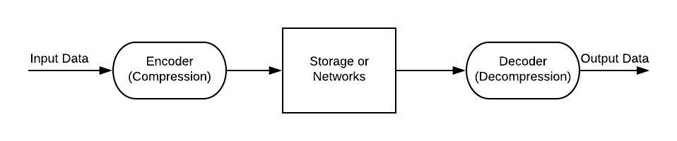
How does it Work?
  Reads sequence of symbols, groups symbols into strings and converts them into codes.
  Uses a code table dictionary with generally 4096 (12 bits) entries.
  Encoding: Identifies repeated sequences of data and adds them to the code table (256-4095)
  Decoding: Reads each code in compressed file and translates using the dictionary.

Slide 7
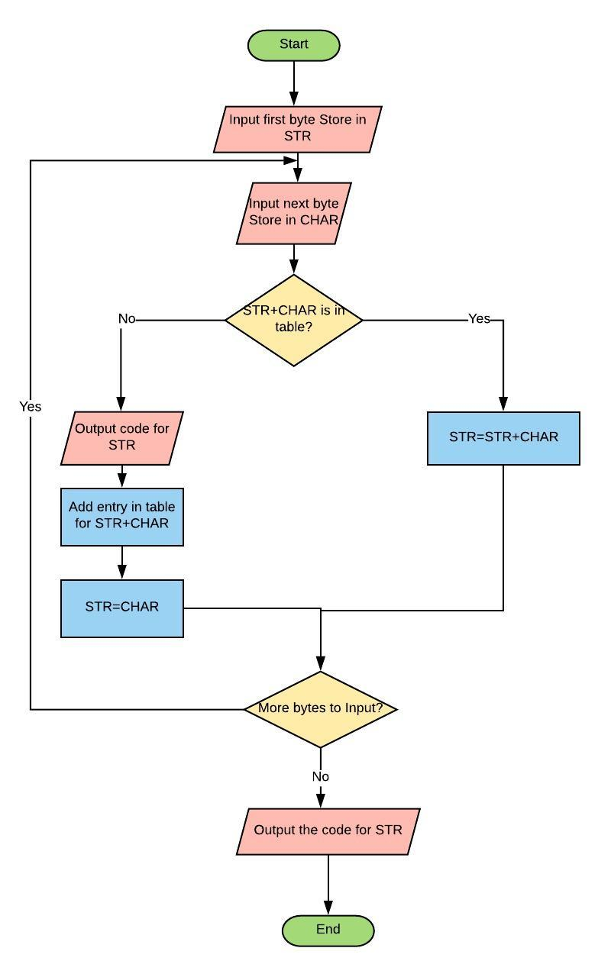
LZW Compression Flowchart

Slide 8
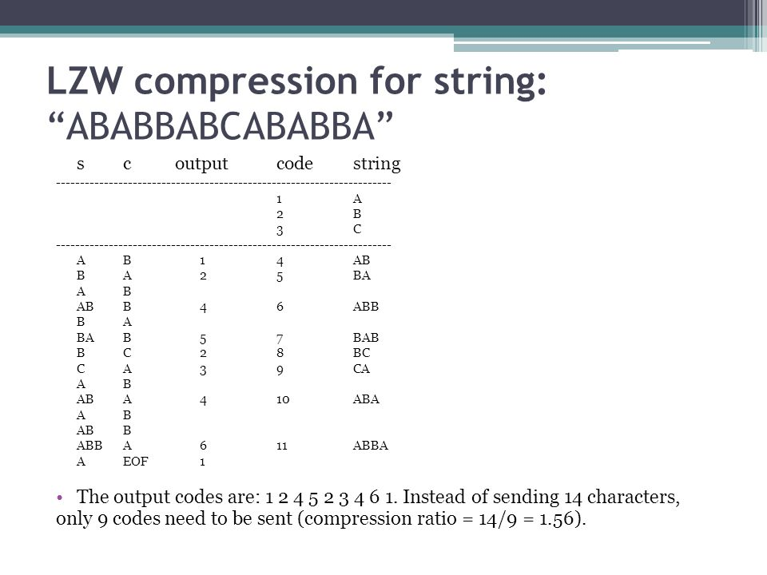
LZW Compression Example

Slide 9
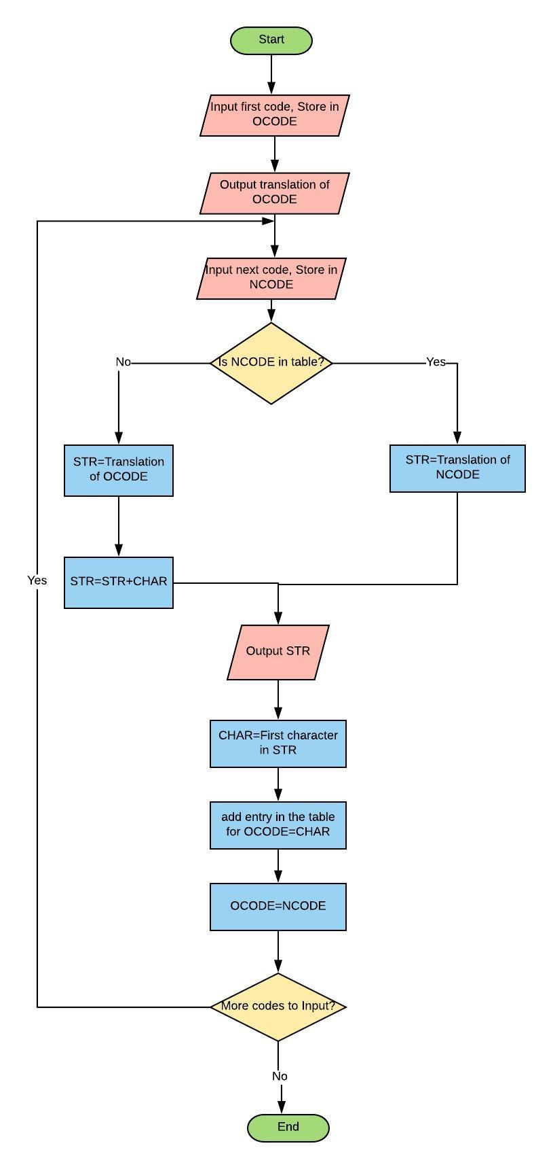
LZW Decompression Flowchart

Slide 10
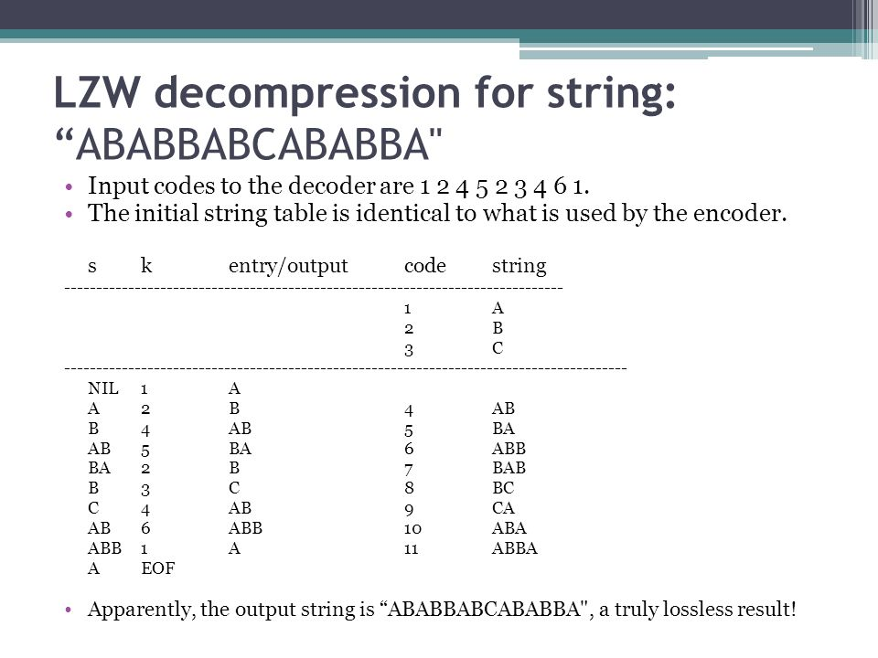
LZW Decompression Example

Slide 11
Implementation Codes
Dictionary implemented as Linear Array
  LZWLA_Compress.cpp
  LZWLA_Decompress.cpp
Dictionary implemented as a BST
  LZWbst_Compress.cpp
  LZWbst_Decompress.cpp
Dictionary implemented as Chained Hash Table
  LZWhashtable_Compress.cpp
  LZWhashtable_Decompress.cpp

Slide 12
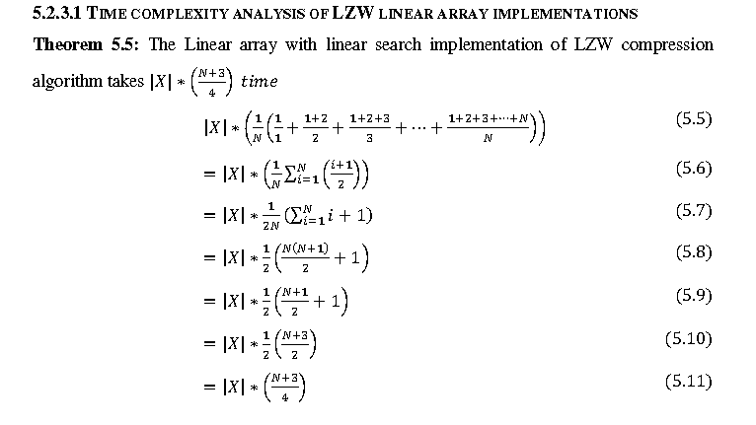
Linear Array (Compression) Complexity Analysis

Slide 13
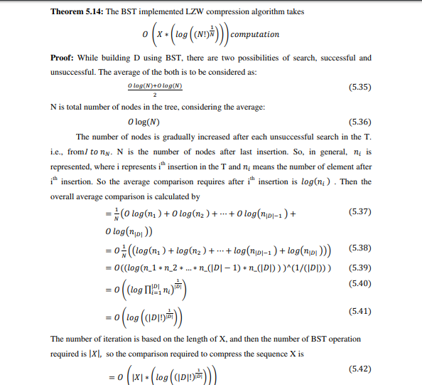
BST (Compression)
Complexity Analysis

Slide 14
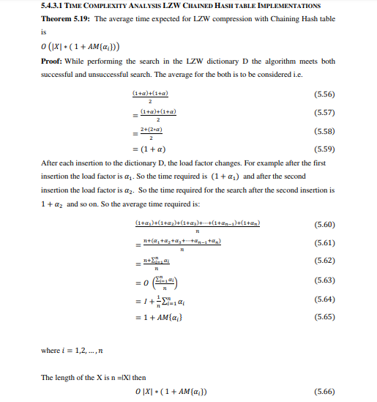
Chained HashTable (Compression) Complexity Analysis

Slide 15
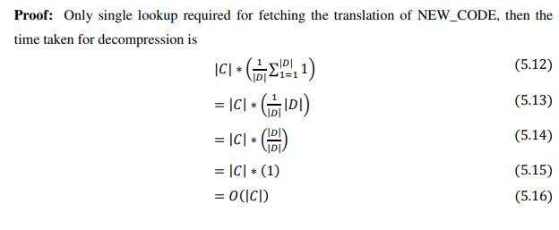
Decompression Complexity Analysis
  For all the three implementations, Time Complexity for Decompression comes out to be the same, since no searching is required as translations are accessed in constant time.

Slide 16
Testing
The Linear Array, BST and Hash Table implementations are tested on the following text files.
anne.txt
musk.txt
world95.txt
repet.txt
The 1st 3 files are popularly used for testing compression and decompression algorithms. The 4th file is generated by repeating a certain text 10,000 times.

Slide 17
Results
Compression
Type/File | anne | musk | world95 | repet
Hash | 0.765 | 3.047 | 3.391 | 0.828
BST | 3.938 | 5.844 | 8.141 | 1.937
Linear Array | 427.807 | 1490.609 | 2855.89 | 25
Decompression
Type/File | anne | musk | world95 | repet
Hash | 0.265 | 0.375 | 0.641 | 0.047
Bst | 0.56 | 1.609 | 1.672 | 0.063
Linear Array | 0.109 | 0.265 | 0.391 | 0.079
All values are in seconds

Slide 18
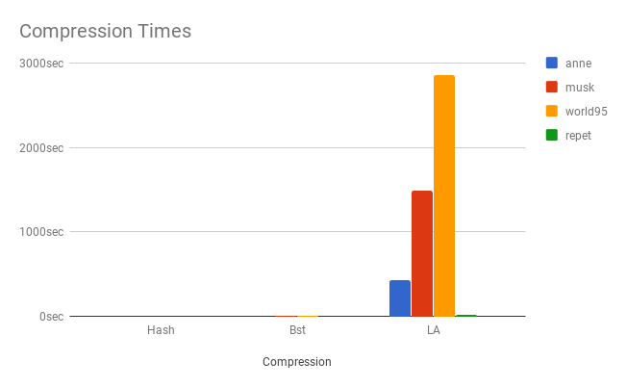
Comparison Charts

Slide 19
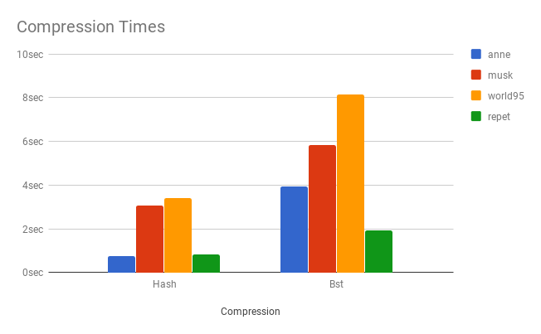
Comparison Charts

Slide 20
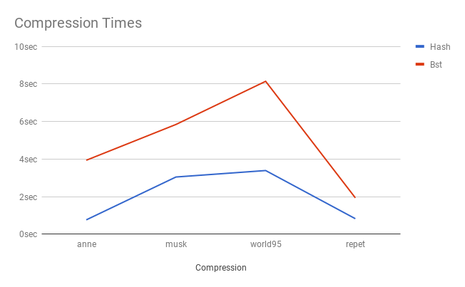
Comparison Charts

Slide 21
Optimization using
Accelerated Dictionary
Motivation
LZW uses the following scheme for loading strings into the dictionary:
If the sequence of strings that are matched is L₁, L₂, L₃..., then LZW adds new strings of the form L₁P₁(L₂), L₂P₁(L₃), L₃P₁(L₄)... where P_{k}(L_{i}) represents the k-character prefix of string L_{i}.
But it is easy to imagine schemes in which strings of the form L₁L₂L_{3...} get loaded, or strings of the form S₁(L₁)L₂, S₁(L₂)L₃... get loaded where S_{k}(L_{i}) represents the k-character suffix of string L_{i}

Slide 22
Optimization using
Accelerated Dictionary
Proposal
PREFIX PROPERTY
We require that if L_{i} is a string in the dictionary then every prefix of L_{i} must also be present.
A NEW PROPOSAL TO ADD POTENTIAL STRINGS
If the sequence of strings matched by the compression algorithm is L₁, L₂, L₃ ... as before, then the standard LZW algorithm will add strings of the form L_{i}P₁(L_{i+1}). We propose adding several strings of the form:
L_{i}P_{k}(L_{i+1}) for k = 1,2, ... Min ( maxlen, lL_{i+1}l )
where maxlen imposes a maximum limit on k .

Slide 23
Optimization using
Accelerated Dictionary
Example
Consider the input source is the string “abcdefg ...”.
If LZW matches it as the two strings “abc” and “defg”, it will add just “abcd” to its dictionary.
We propose also adding “abcde” when maxlen>=2, and adding “abcdef’ when marlen>=3, and so on.
The rationale is that if the substring “abcdefg” occurs a second time in the input, LZW will now add “abcde” to the dictionary. If “abcdefg” occurs for a third time, LZC will
next add “abcdef’, and so on .

Slide 24
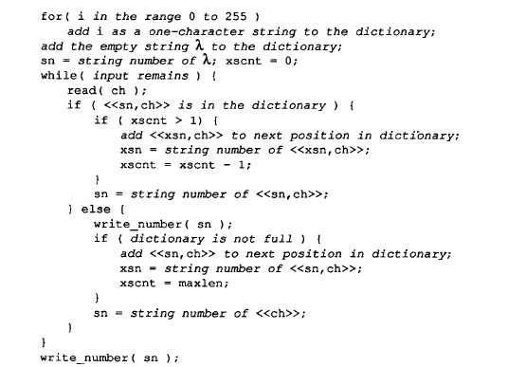
Optimization using
Accelerated Dictionary
Algorithm

Slide 25
Implementation Code
  Accelerated_dictionary_compress.cpp Accelerated_dictionary_decompress.cpp
Compression Results
Type/File | anne | musk | world95 | repet
Orignal File | 591815 | 1348155 | 3005020 | 770000
LZW (Hash) | 241834 | 511324 | 1144826 | 6,554
LZWA (m=1) | 241834 | 511324 | 1144826 | 6,554
LZWA (m=2) | 240662 | 521308 | 1185724 | 4,646
LZWA (m=3) | 242932 | 527368 | 1207506 | 3,800
LZWA (m=4) | 242932 | 536104 | 1216484 | 3,298
All values are in bytes

Slide 26
Optimization using
Accelerated Dictionary
A NOTE ON THE VALUE OF k:
Experimental data shows that increasing the maximum allowed value for k improves compression performance but causes the dictionary to fill at a much faster rate.
We should be careful not to load strings into the dictionary at too fast a rate - otherwise the compression and decompression algorithms may spend too much time
updating the dictionary and they will also have to handle dictionary overflow much earlier.

Slide 27
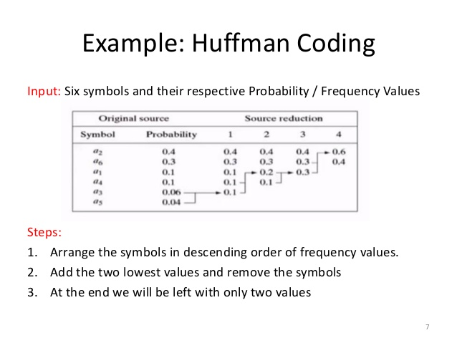
Huffman Coding
Lossless
Assign variable-length codes to input characters
Lengths of the assigned codes based on the frequencies of corresponding characters
Most frequent character - Smallest code
Least frequent character - Largest code
Huffman.cpp

Slide 28
Comparison of LZW with Huffman
LZW
Huffman
Uses frequencies of repitition
Requires no prior information about the input data stream
Compresses input stream in a single pass
Performs better with greater repition of patterns.
Uses frequency of single byte occurence
Requires the frequency of each byte before encoding
Byte frquencies calculated in 1st pass and compression in 2nd pass
Performs better with more diverse input.

